Slide 1
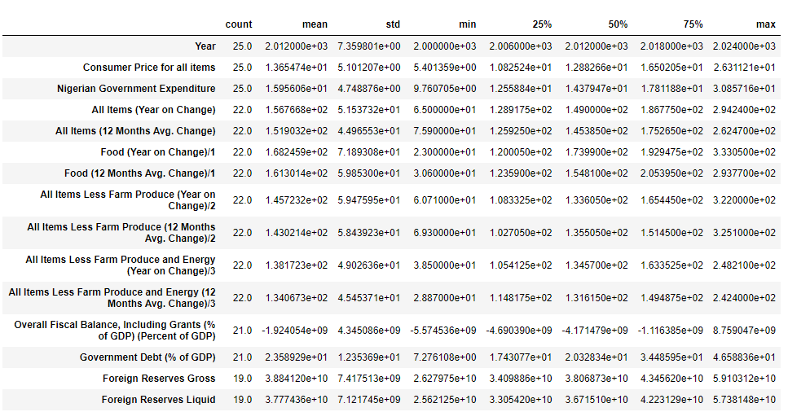
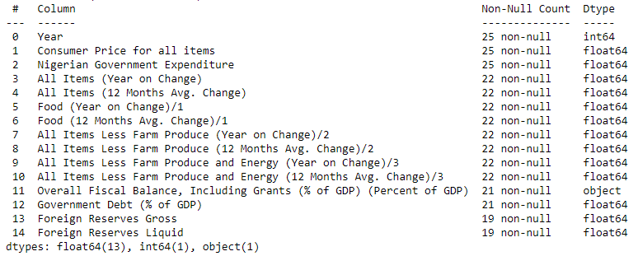
Insight into "2000_onwards” Dataset
Dataset Statistics
Dataset Information
Dataset Dimension: 25 * 15
Dataset: 2000_onwards.csv

Slide 2
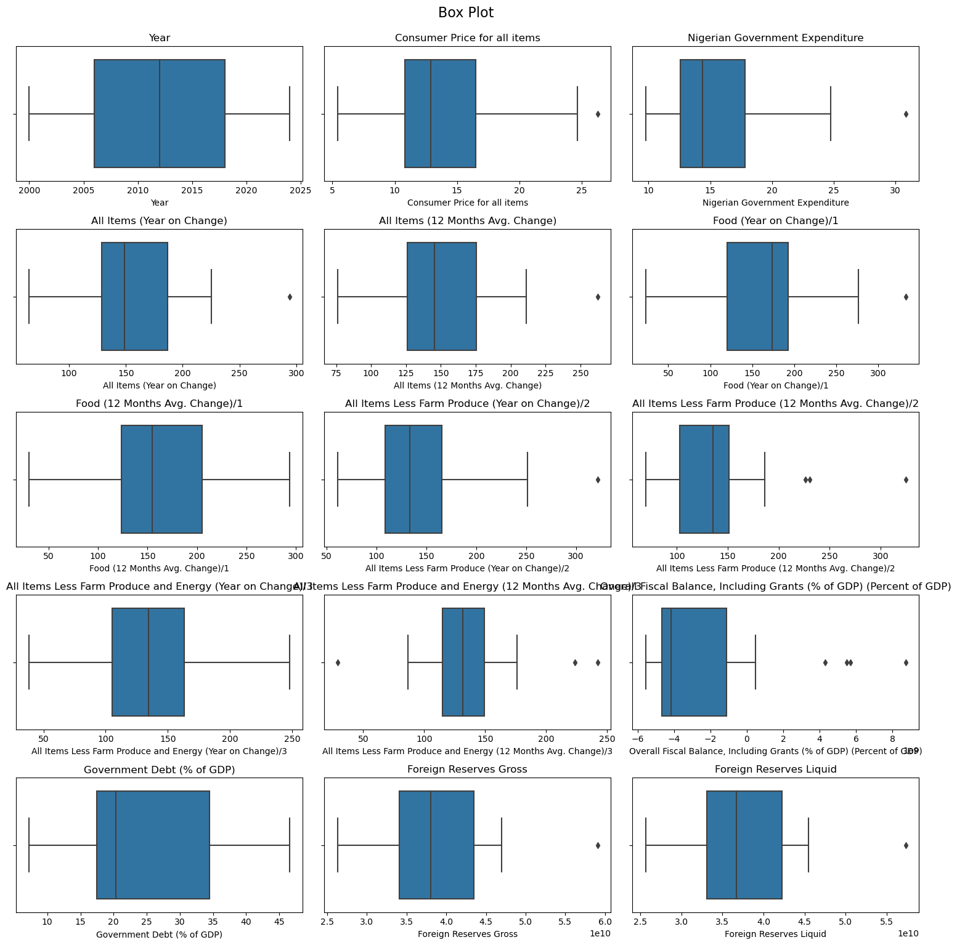
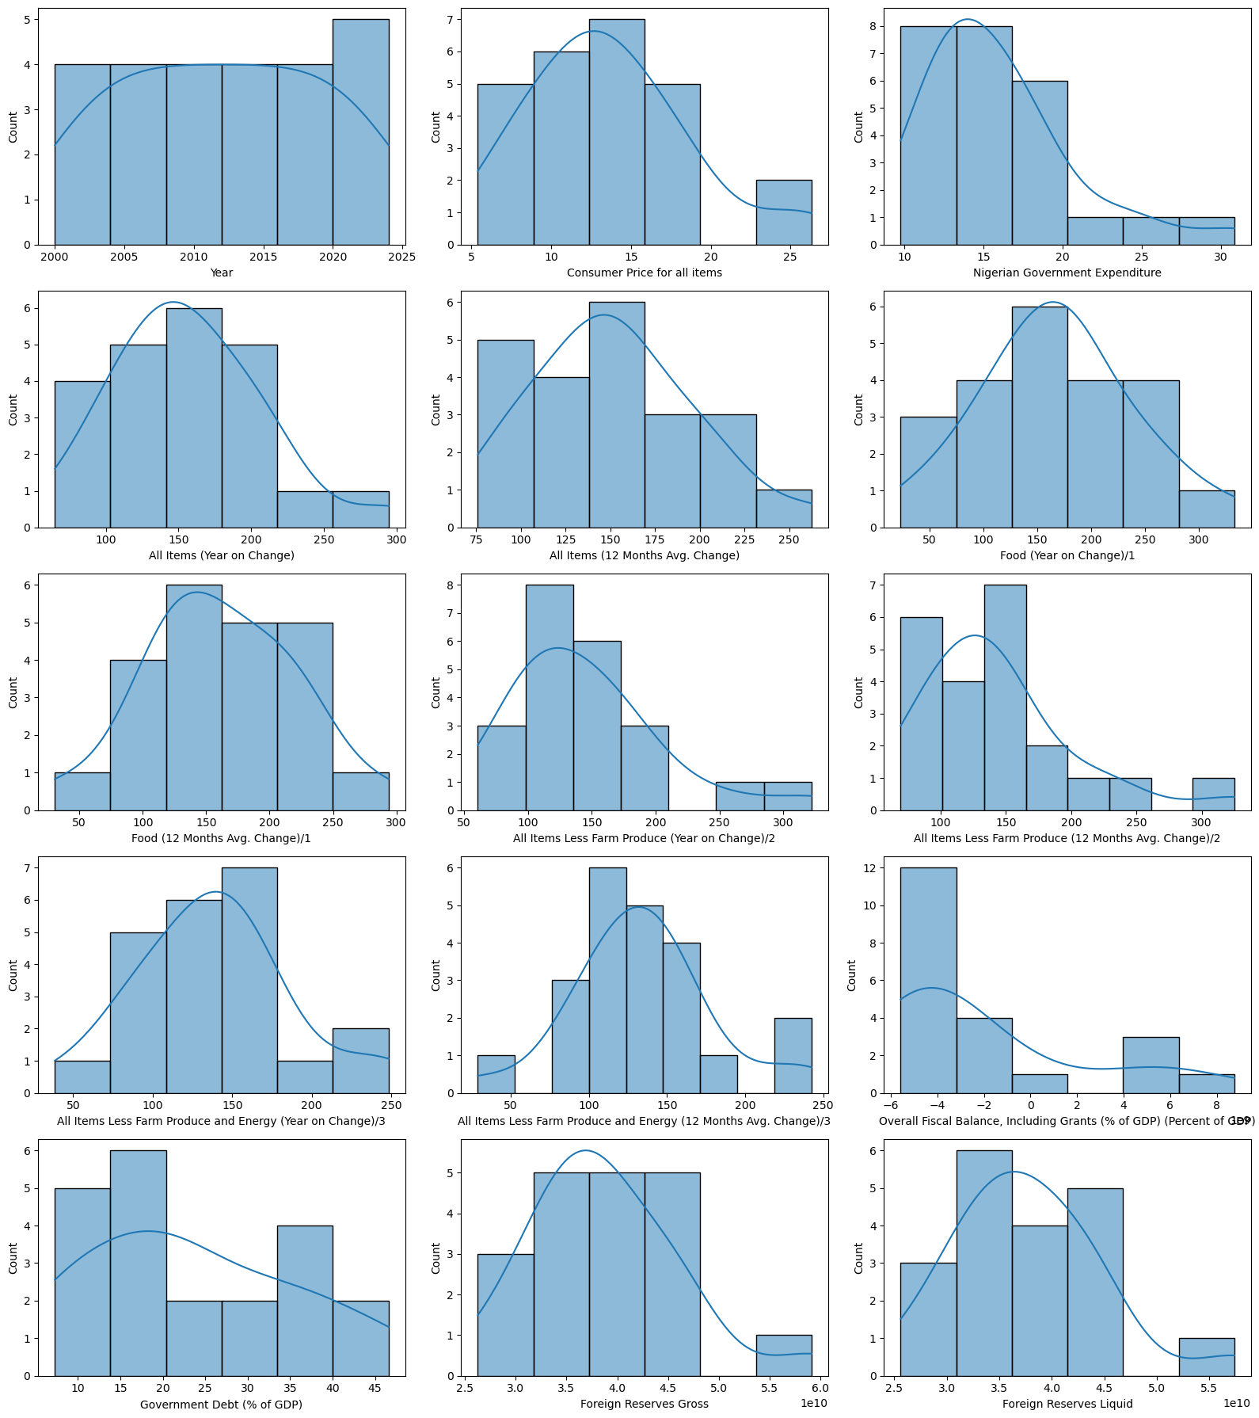
Univariate Analysis – Histogram and Box Plots
Dataset: 2000_onwards.csv

Slide 3
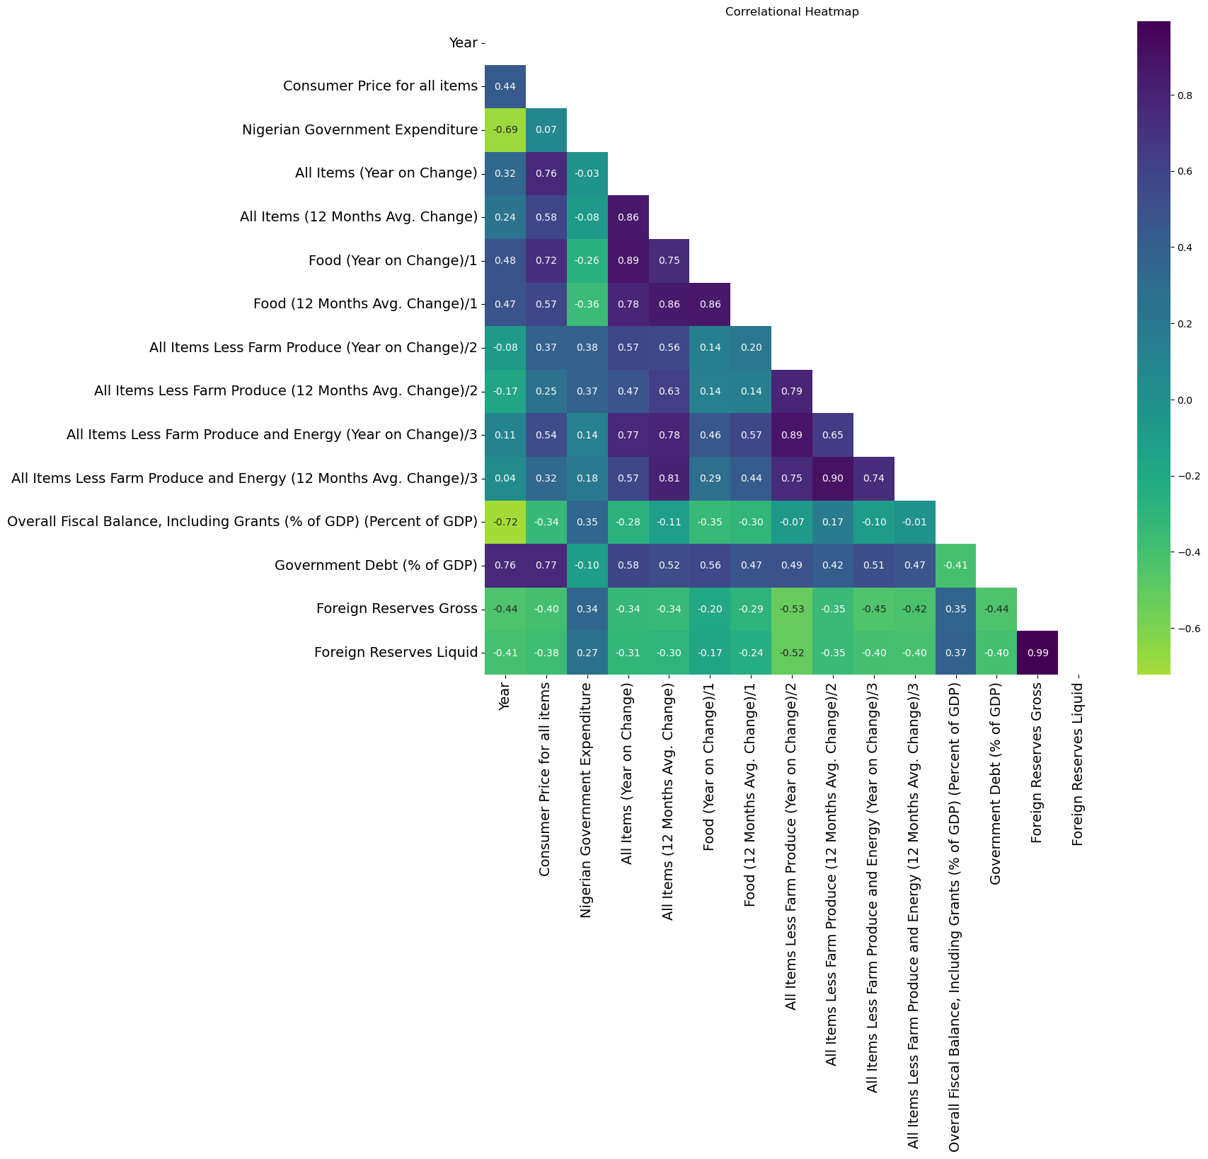
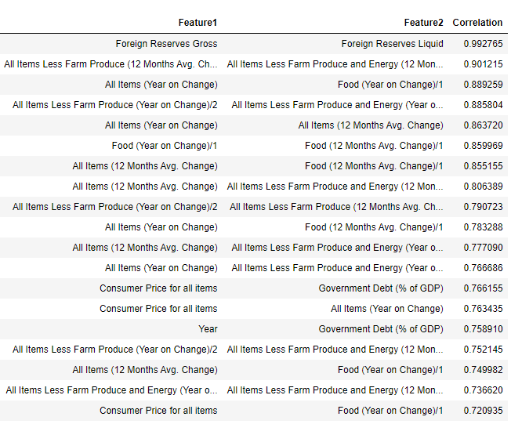
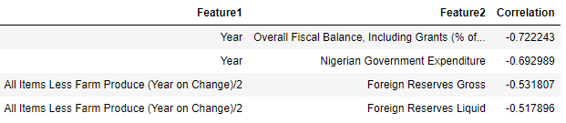
Correlation Analysis
Strongest Positive Correlated Features
Strongest Negative Correlated Features
Dataset: 2000_onwards.csv

Slide 4
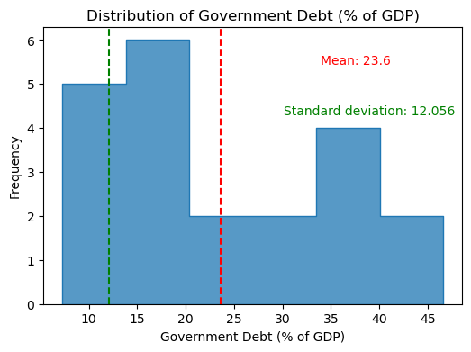
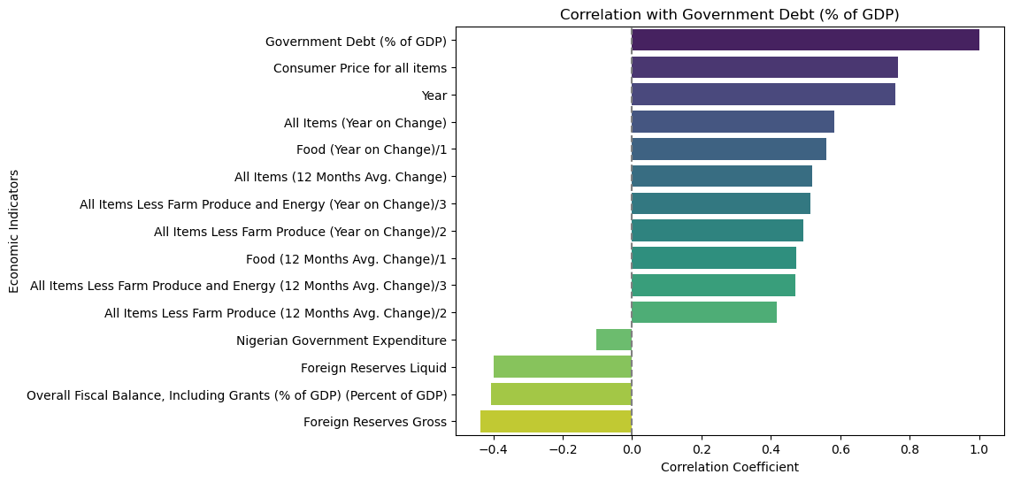
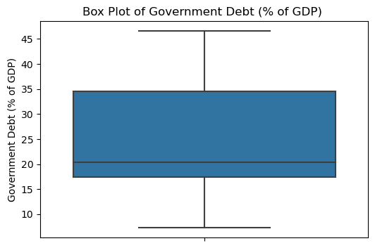
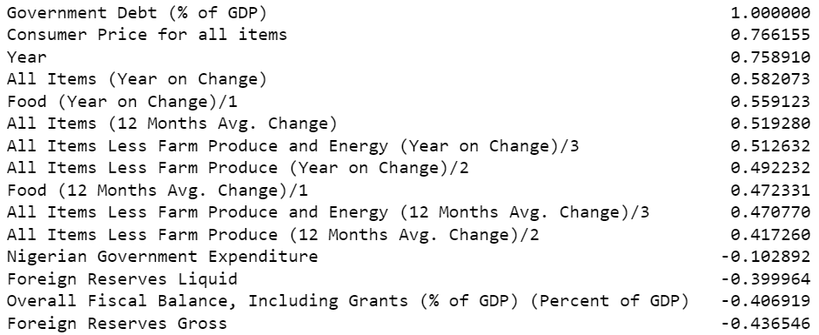
Insight into "Government Debt (% of GDP)"
Correlation with Government Debt (% of GDP)
Dataset: 2000_onwards.csv

Slide 5
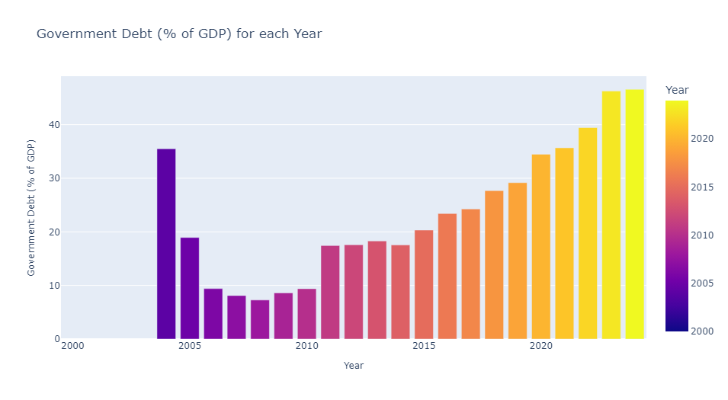
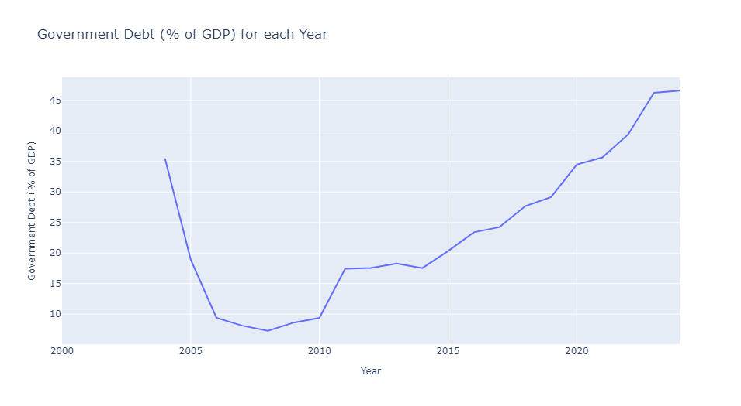
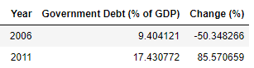
"Government Debt (% of GDP)" and "Year"
In 2004, government debt as a percentage of GDP began at 35.49% and decreased to 18.94% by 2005.
From 2006 to 2008, there was a significant decrease in government debt relative to GDP, reaching a low of 7.28% in 2008.
Debt increased slightly in 2009 (8.62%) and showed a noticeable increase in 2010 (9.39%) and 2011 (17.43%) following global economic challenges.
From 2012 onwards, government debt as a percentage of GDP generally increased steadily, with fluctuations. By 2024, it reached approximately 46.59%.
Significant “Government Debt (% of GDP)" Changes
In 2006, there was a notable decrease in government debt relative to GDP, reducing by over 50%, indicating substantial fiscal consolidation or reduced borrowing.
In 2011, There was a significant increase in government debt relative to GDP, rising by over 85%, suggesting increased borrowing, possibly due to economic policies or higher spending needs
Dataset: 2000_onwards.csv

Slide 6
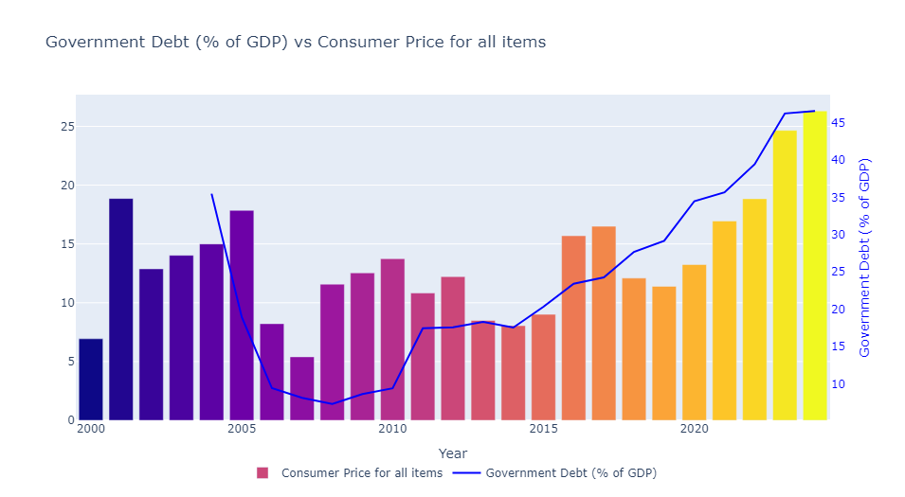
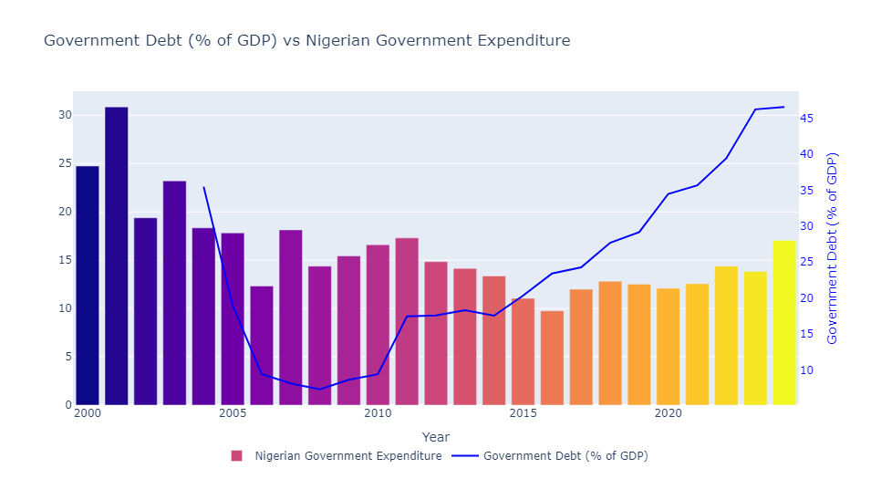
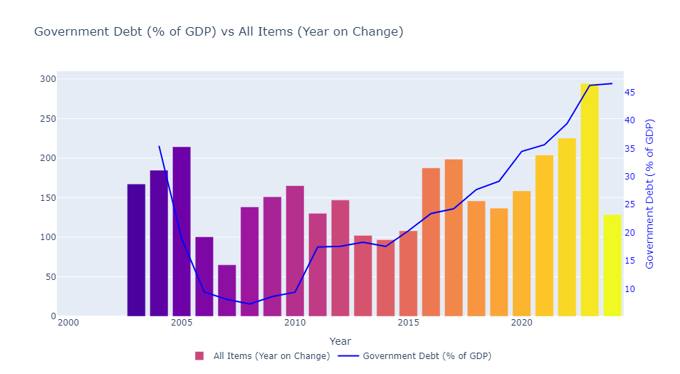
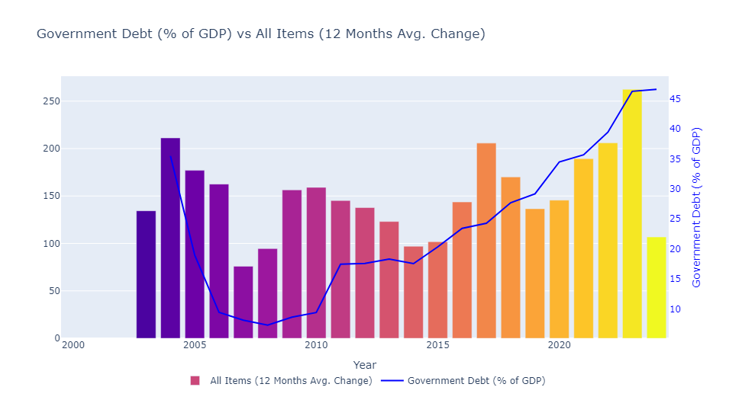
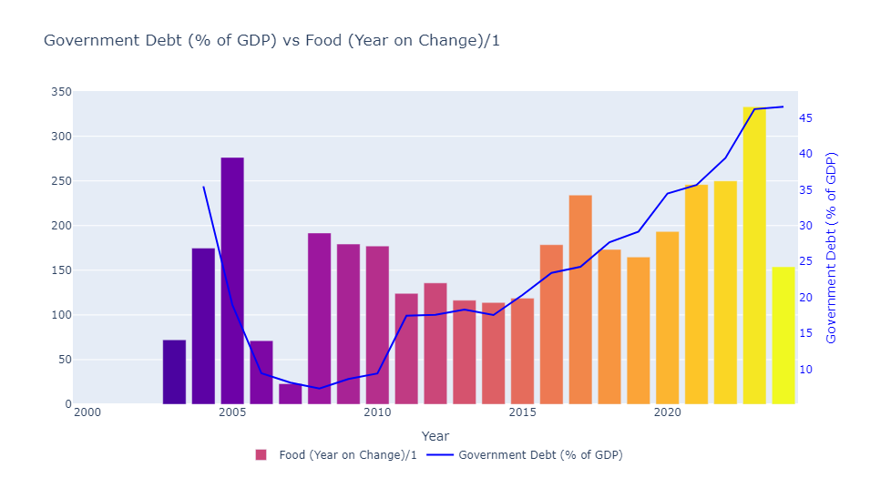
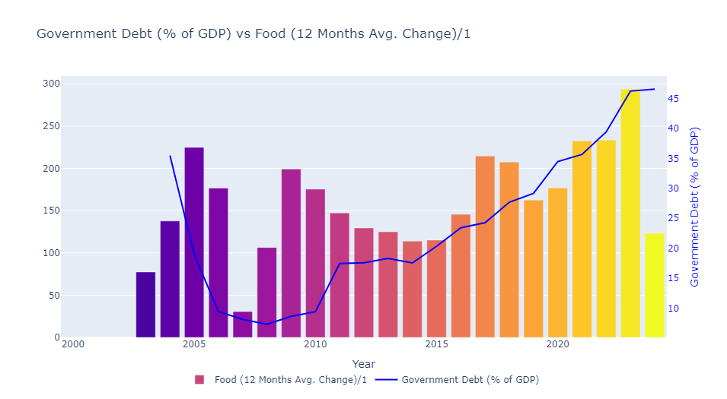
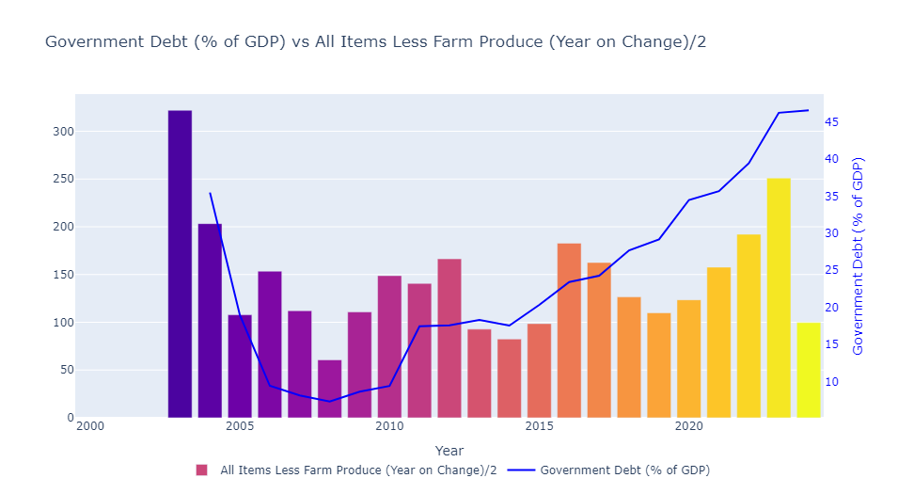
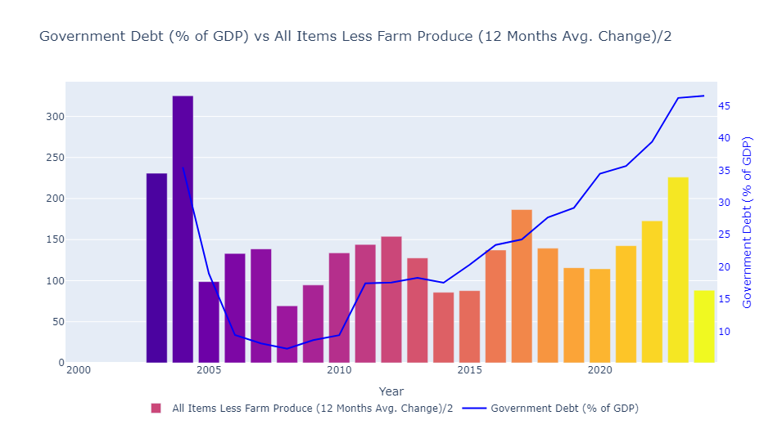
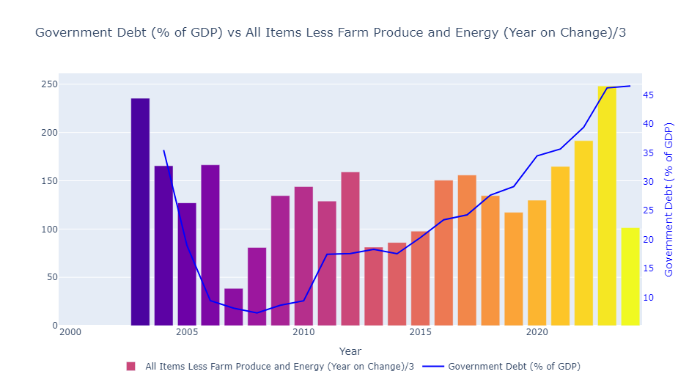
Insight into "Government Debt (% of GDP)" and Economic Indicators – Bar Plots

Slide 7
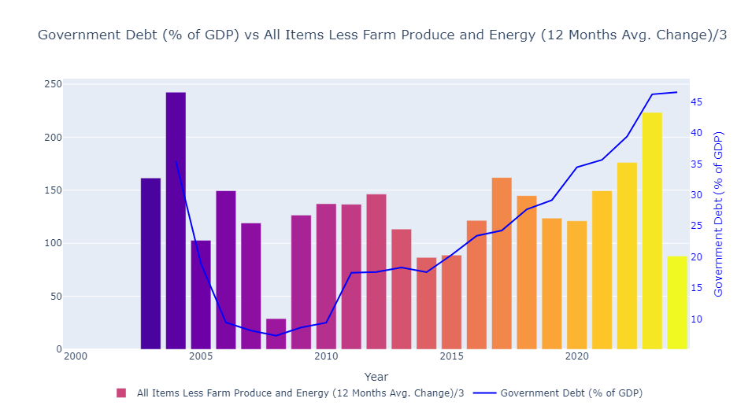
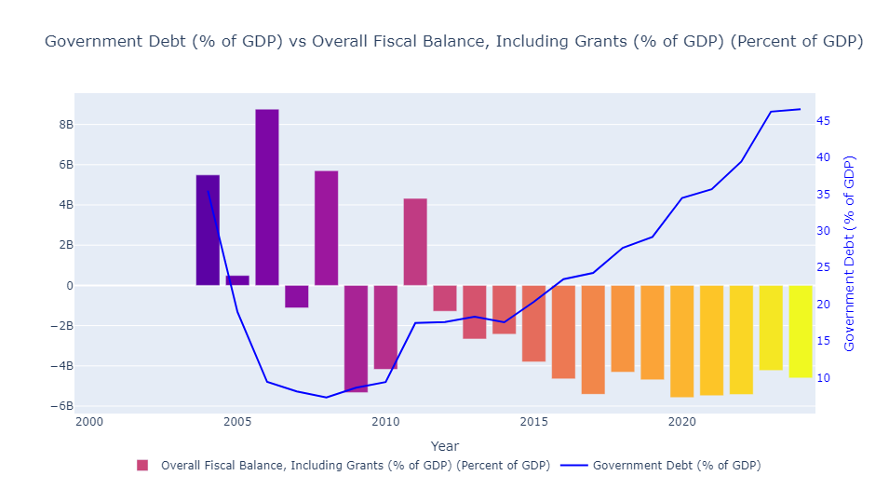
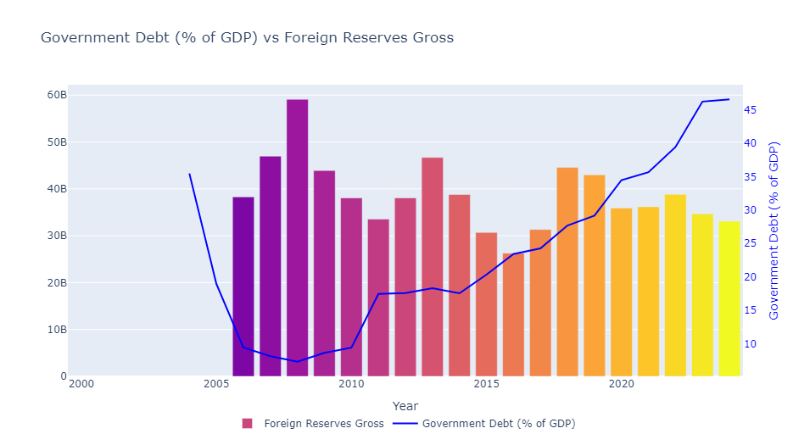
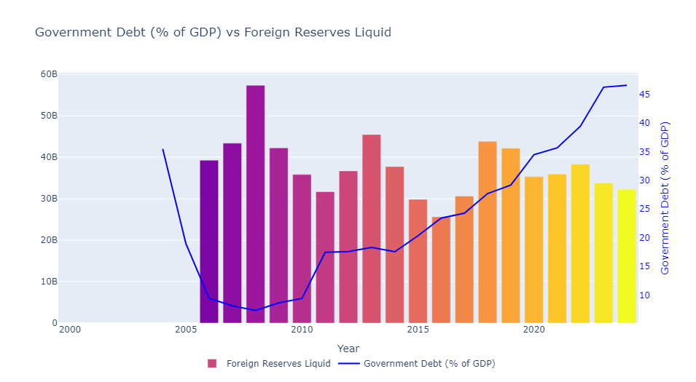
Insight into "Government Debt (% of GDP)" and Economic Indicators – Bar Plots
Dataset: 2000_onwards.csv

Slide 8
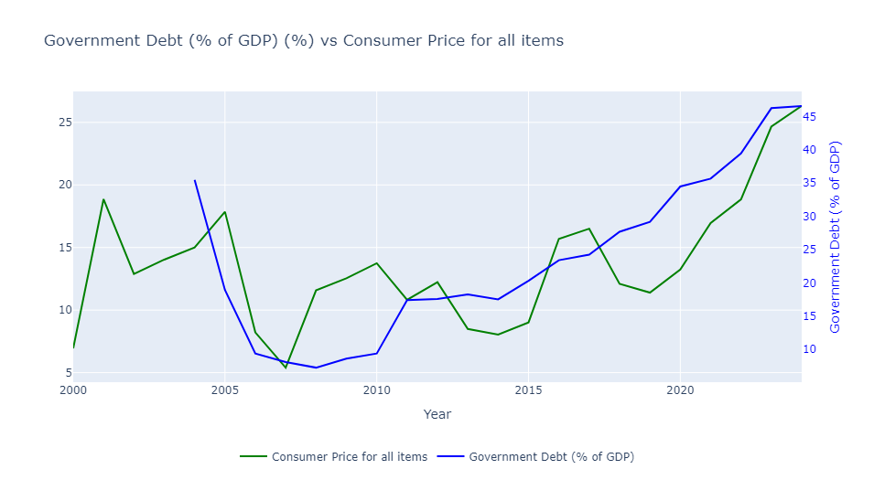
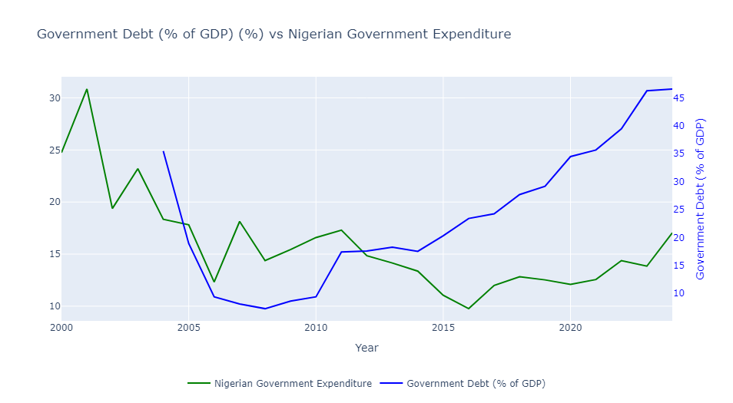
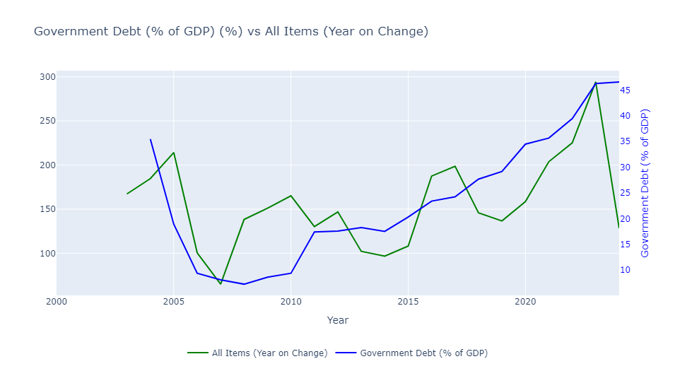

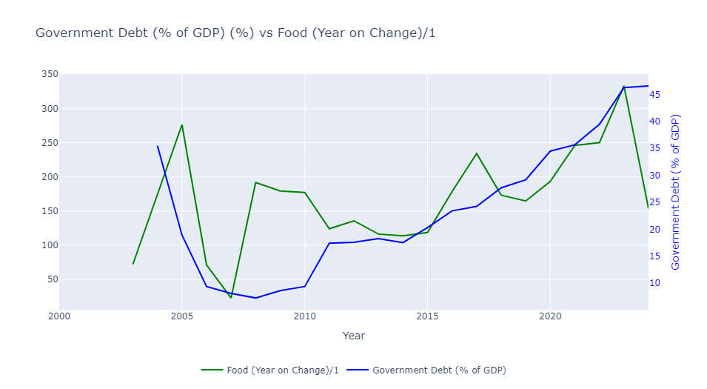
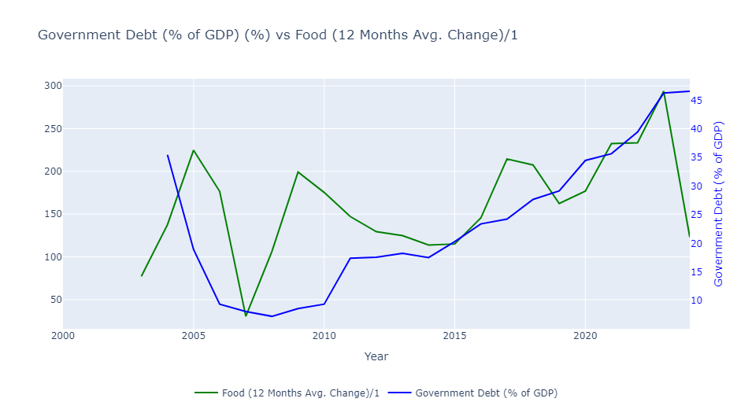
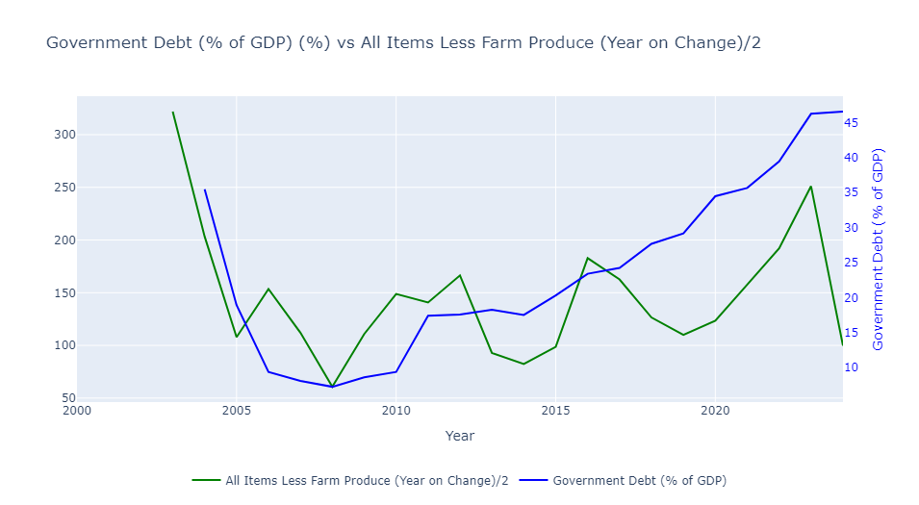
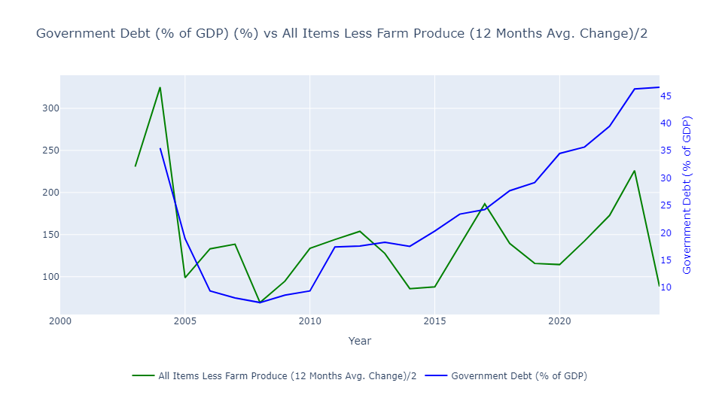
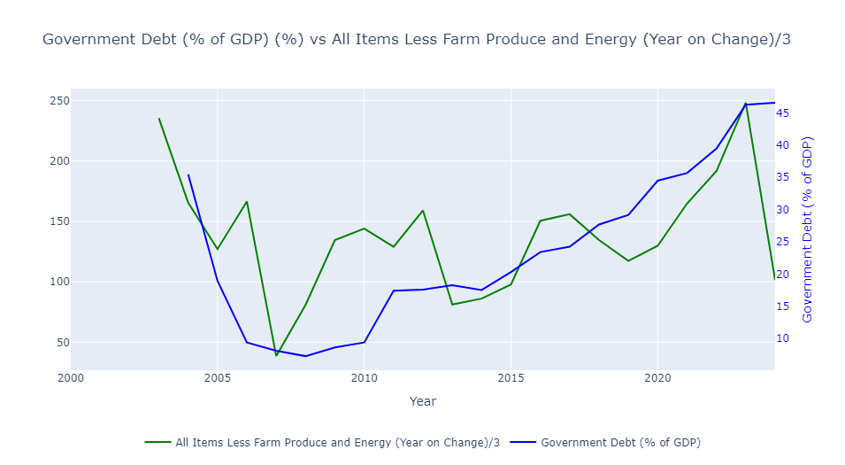
Insight into "Government Debt (% of GDP)" and Economic Indicators – Line Plots

Slide 9
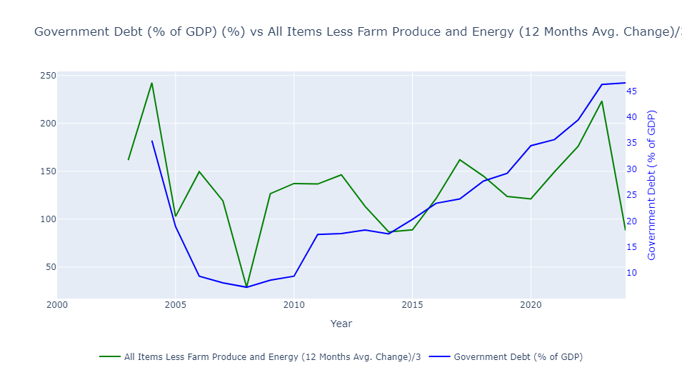
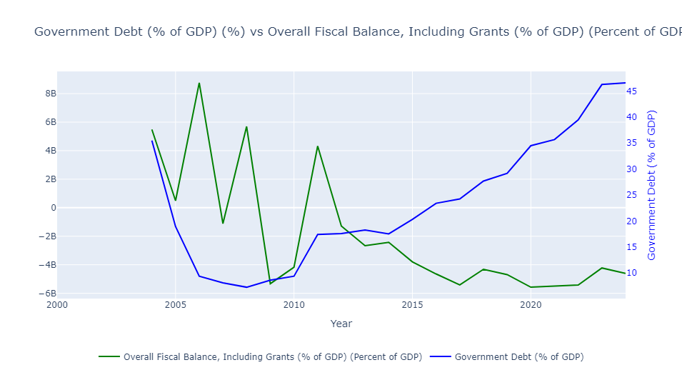
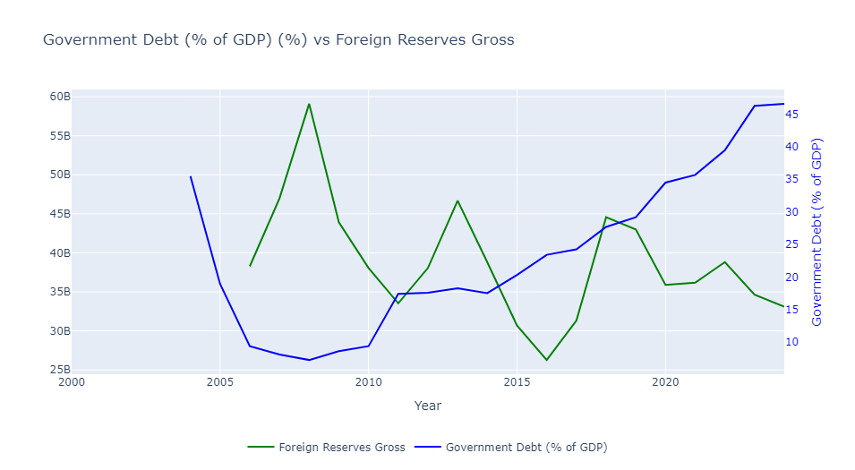
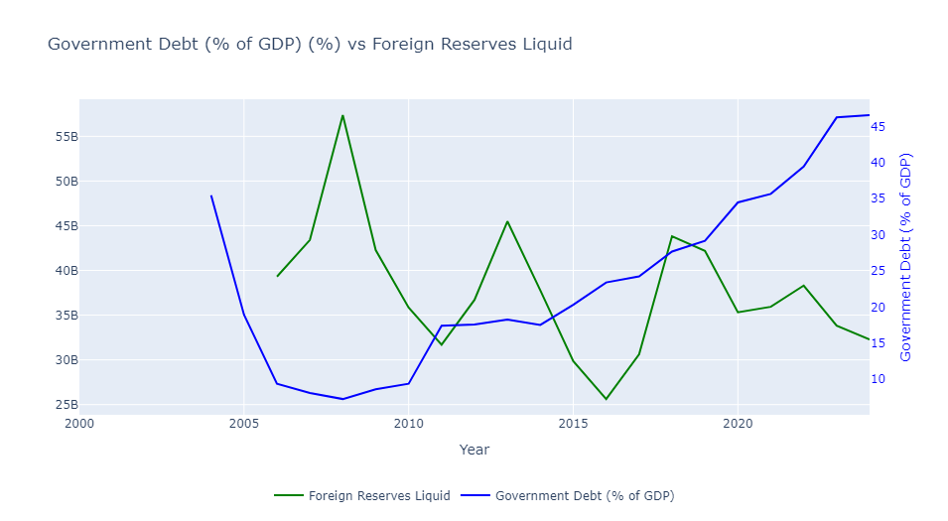
Insight into "Government Debt (% of GDP)" and Economic Indicators – Line Plots
Dataset: 2000_onwards.csv

Slide 10
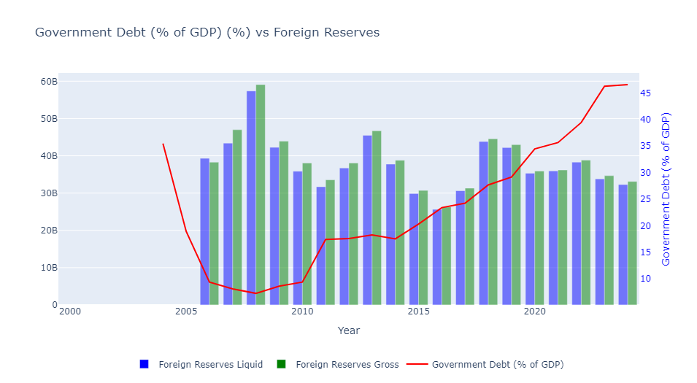
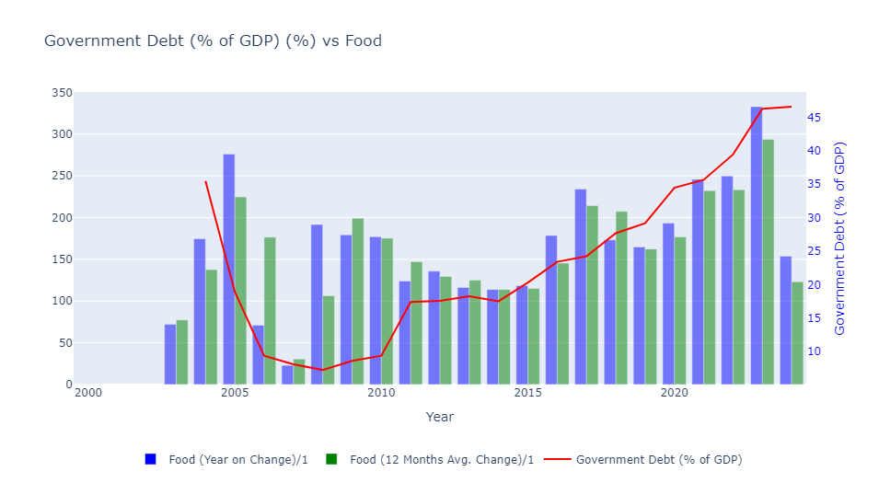
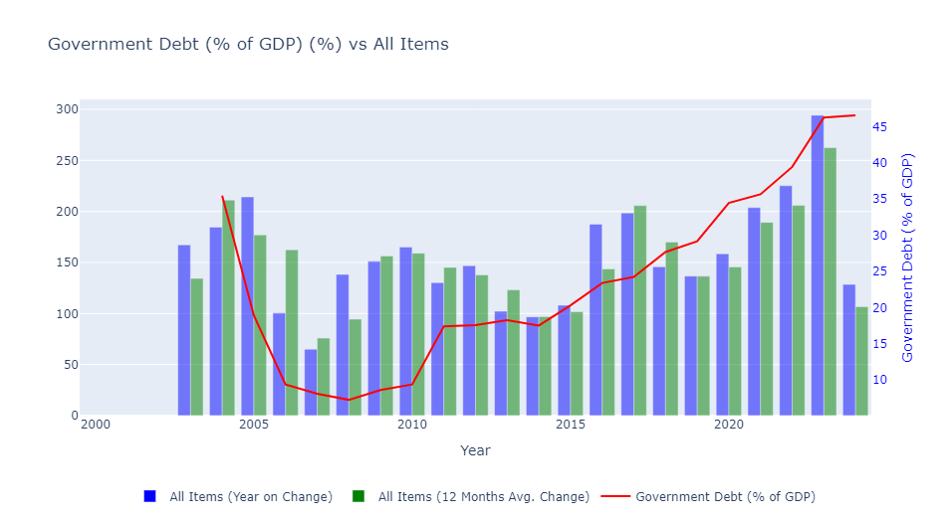
Insight into "Government Debt (% of GDP)" and Foreign Reserves, Food and All Items Indicators
"Government Debt (% of GDP)" and Foreign Reserves
"Government Debt (% of GDP)" and Food
"Government Debt (% of GDP)" and All Items
Dataset: 2000_onwards.csv

Slide 11
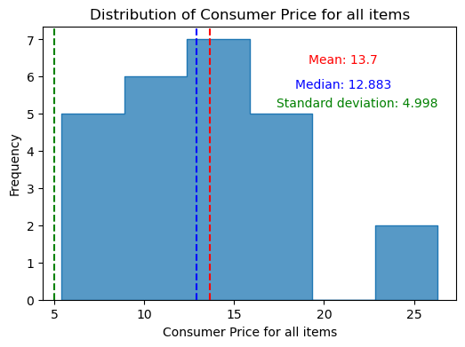
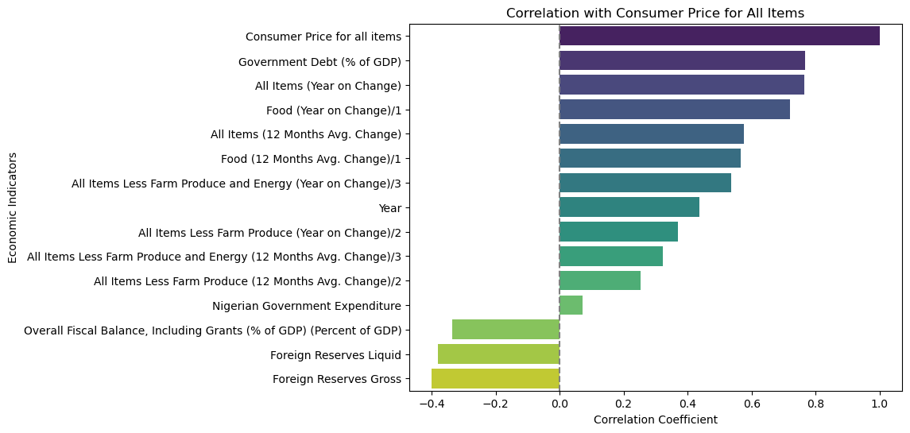
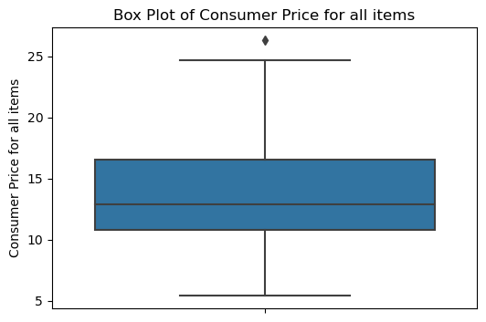
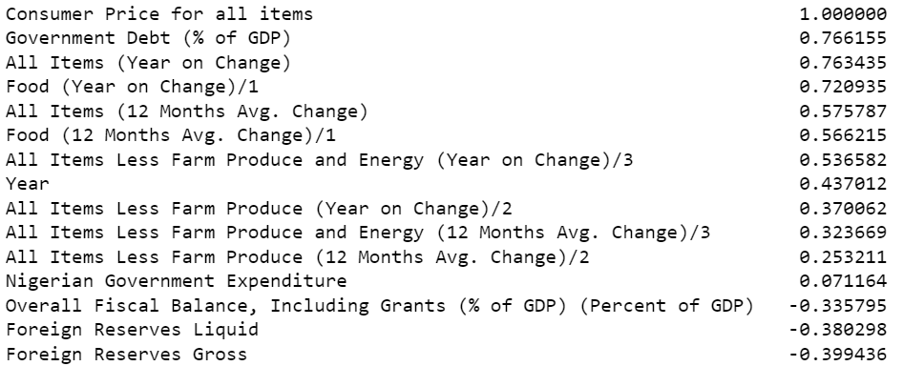
Insight into "Consumer Price for all items"
Correlation with Consumer Price for All Items
Dataset: 2000_onwards.csv

Slide 12
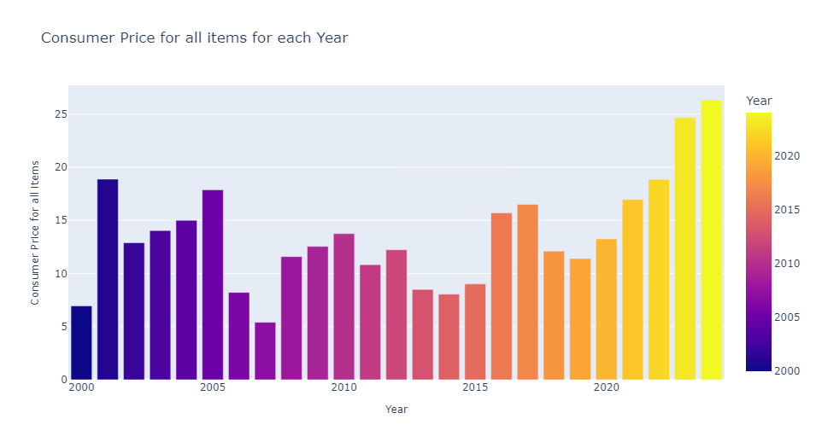
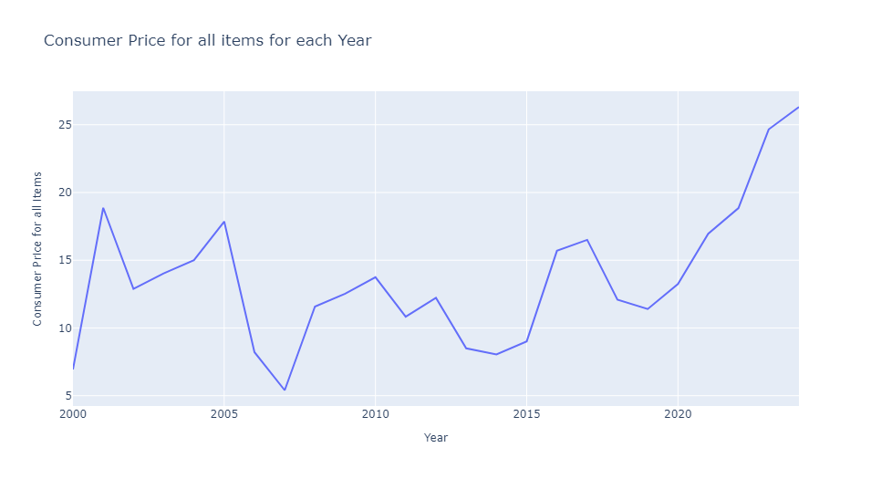
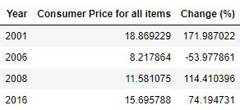
" Consumer Price for all items " and "Year"
The data shows a fluctuating trend in the Consumer Price Index for all items from 2000 to 2024.
The early 2000s experienced high inflation, peaking in 2001.
Mid-decade, there was a notable decrease, particularly in 2007.
The CPI remained relatively stable in the early 2010s but began to rise again towards the end of the decade.
In recent years, there has been an upward trend, with the CPI reaching its highest levels in 2023 and 2024.
Significant “Consumer Price for all items” Changes
In 2001, the CPI surged by 171.99%, followed by a 53.98% decrease in 2006.
It spiked again by 114.41% in 2008 and increased by 74.19% in 2016.
These changes highlight periods of sharp inflation spikes and reductions, indicating considerable volatility in consumer prices over the years
Dataset: 2000_onwards.csv

Slide 13
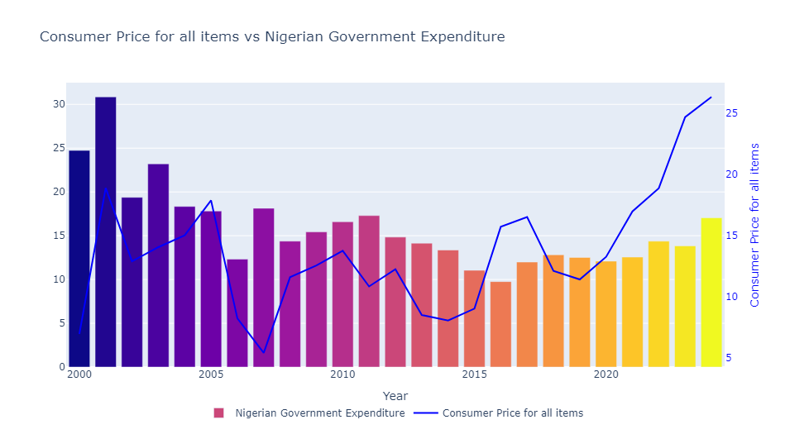







Insight into "Consumer Price for all items" and Economic Indicators – Bar Plots

Slide 14




Insight into "Consumer Price for all items" and Economic Indicators – Bar Plots
Dataset: 2000_onwards.csv

Slide 15









Insight into "Consumer Price for all items" and Economic Indicators – Line Plots

Slide 16




Insight into "Consumer Price for all items" and Economic Indicators – Line Plots
Dataset: 2000_onwards.csv

Slide 17



Insight into "Consumer Price for all items " and Foreign Reserves, Food and All Items Indicators
"Consumer Price for all items" and Foreign Reserves
"Consumer Price for all items" and Food
"Consumer Price for all items" and All Items
Dataset: 2000_onwards.csv

Slide 18




Insight into "Nigerian Government Expenditure"
Correlation with Nigerian Government Expenditure
Dataset: 2000_onwards.csv

Slide 19



" Nigerian Government Expenditure" and "Year"
Government expenditure generally shows a declining trend from 2000 to around 2006, followed by fluctuations with no clear upward or downward trend until 2015.
Expenditure remained relatively stable from 2016 to 2021, with slight fluctuations.
In 2022 and 2023, there was a slight increase in expenditure, possibly indicating economic adjustments.
A notable increase in 2024 suggests a potential shift in fiscal policy or economic priorities.
Significant “Nigerian Government Expenditure” Changes
In 2002, there was a significant decrease of approximately -37.19% in government expenditure compared to 2001.
In 2006, government expenditure decreased significantly by about -30.85% compared to 2005.
In 2007, there was a notable increase of about 47.23% in government expenditure compared to 2006.
Dataset: 2000_onwards.csv

Slide 20









Insight into "Nigerian Government Expenditure" and Economic Indicators – Bar Plots

Slide 21




Insight into "Nigerian Government Expenditure" and Economic Indicators – Bar Plots
Dataset: 2000_onwards.csv

Slide 22









Insight into "Nigerian Government Expenditure" and Economic Indicators – Line Plots

Slide 23




Insight into "Nigerian Government Expenditure" and Economic Indicators – Line Plots
Dataset: 2000_onwards.csv

Slide 24



Insight into "Nigerian Government Expenditure" and Foreign Reserves, Food and All Items Indicators
" Nigerian Government Expenditure " and Foreign Reserves
" Nigerian Government Expenditure " and Food
" Nigerian Government Expenditure " and All Items
Dataset: 2000_onwards.csv

